Slide 1
Reflection of light remove

Slide 2
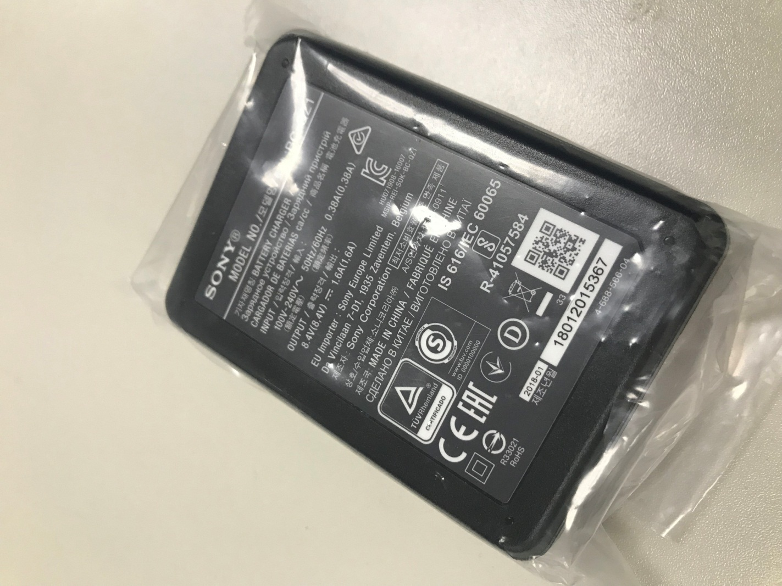
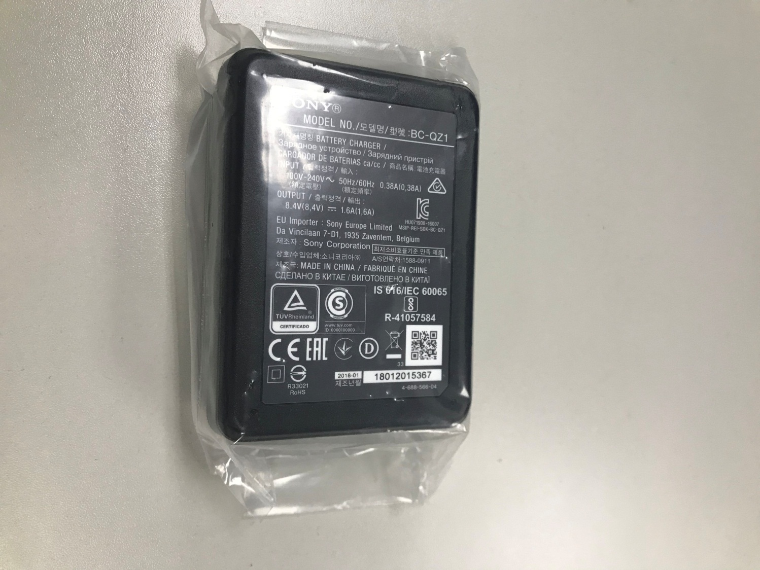
input
P0
P1
Notes:
1

Slide 3
input
P0
P1
Notes:
1

Slide 4
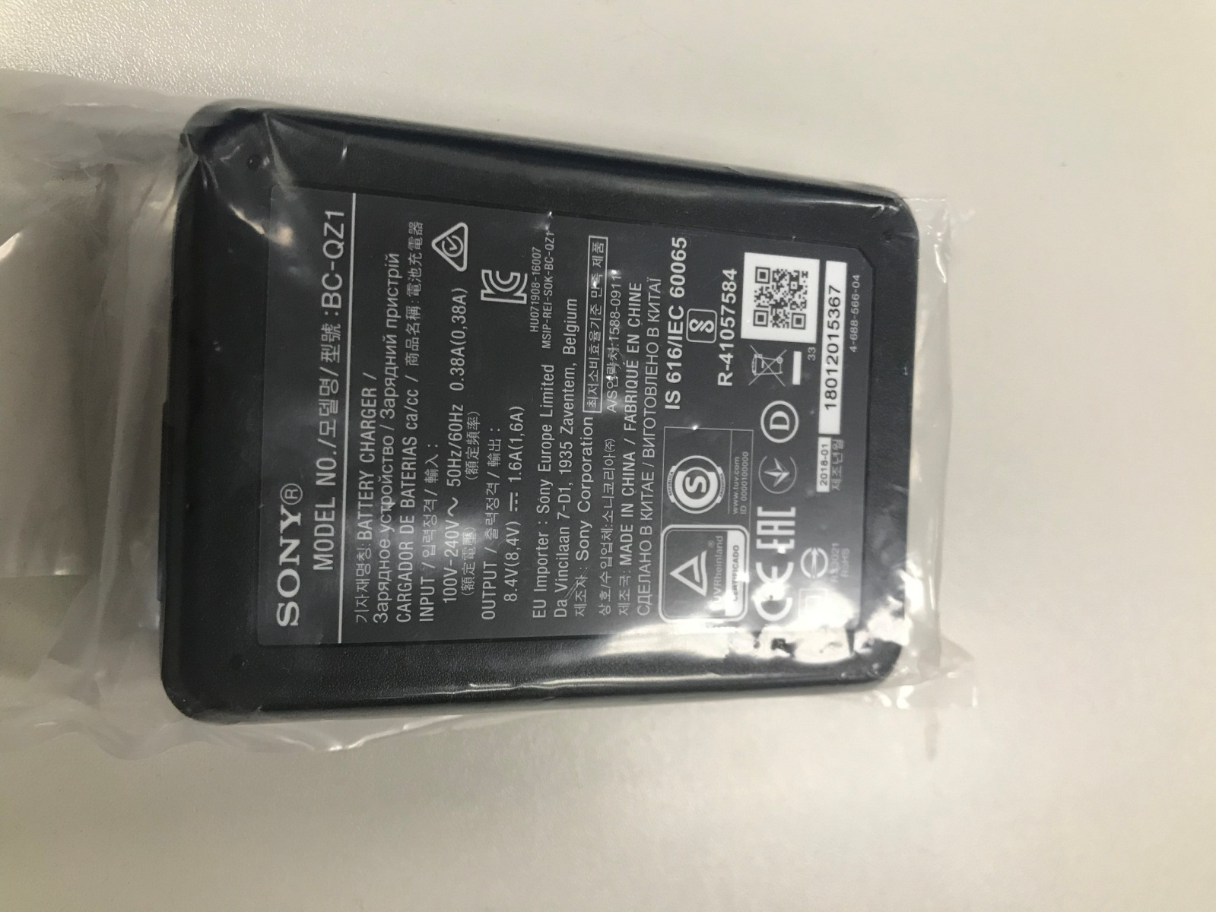
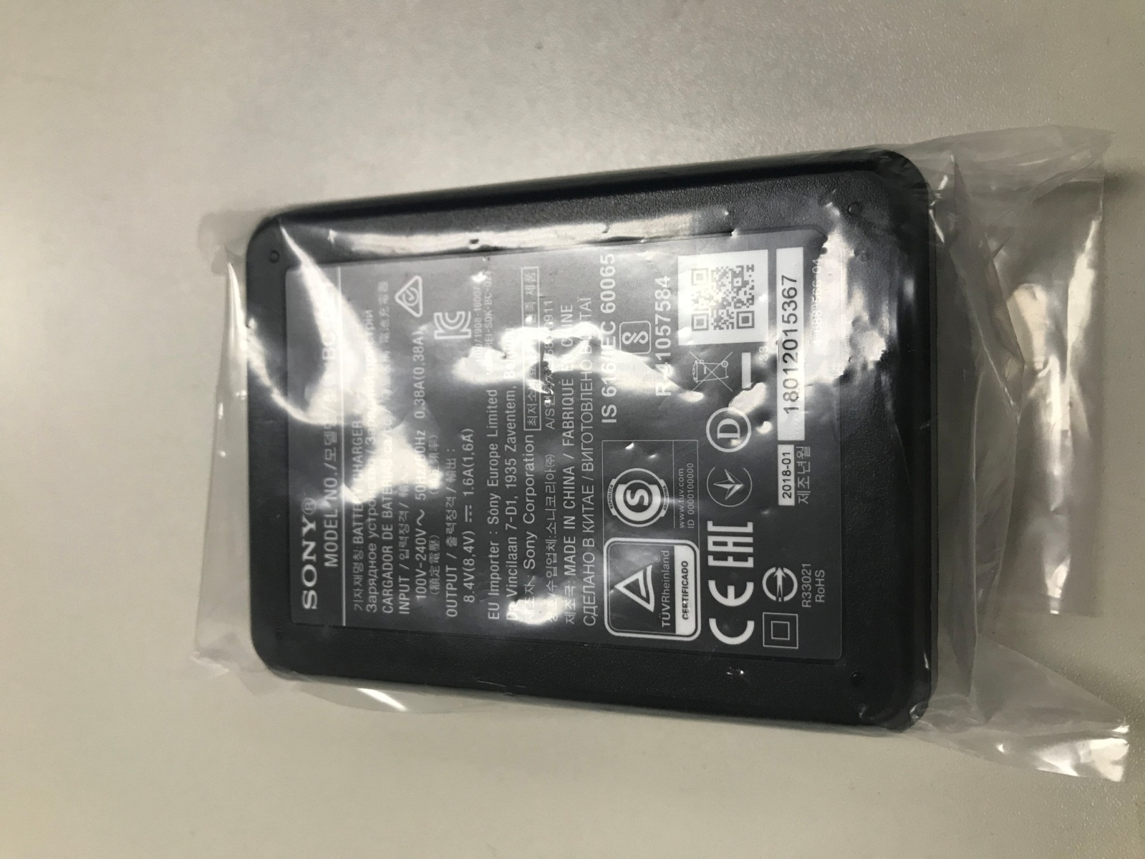
input
P2
P3

Slide 5
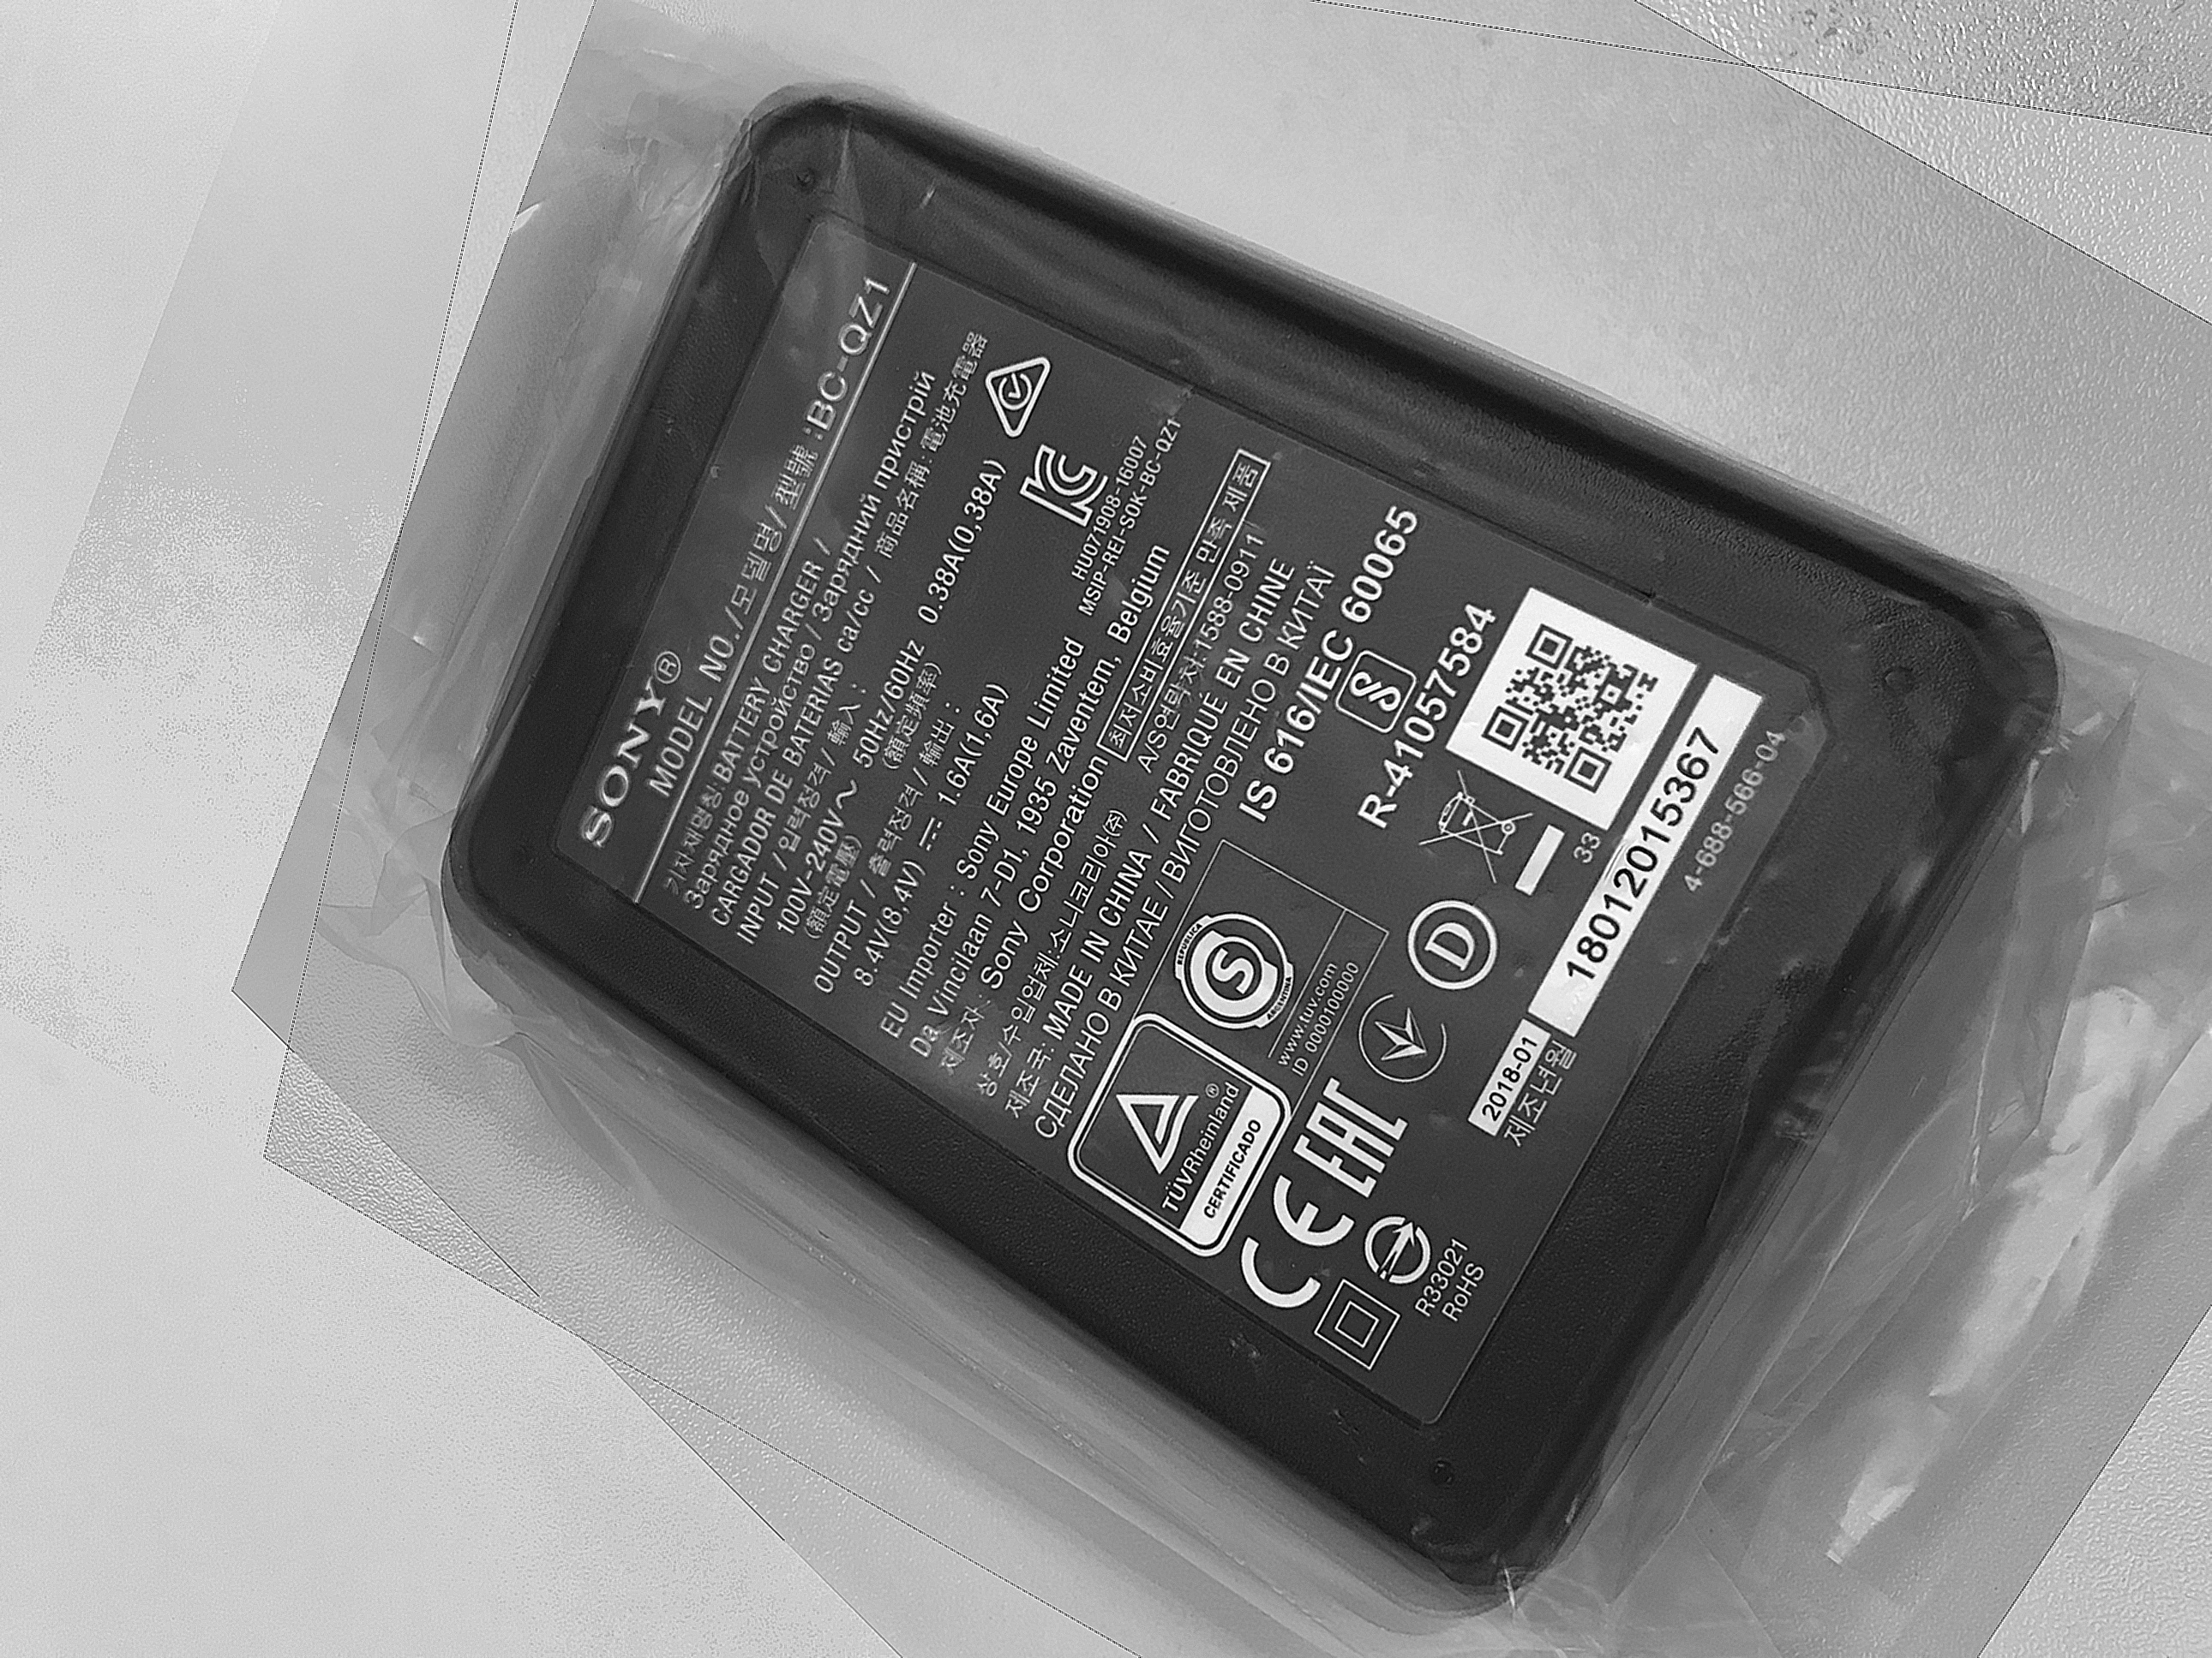
Result

Slide 6
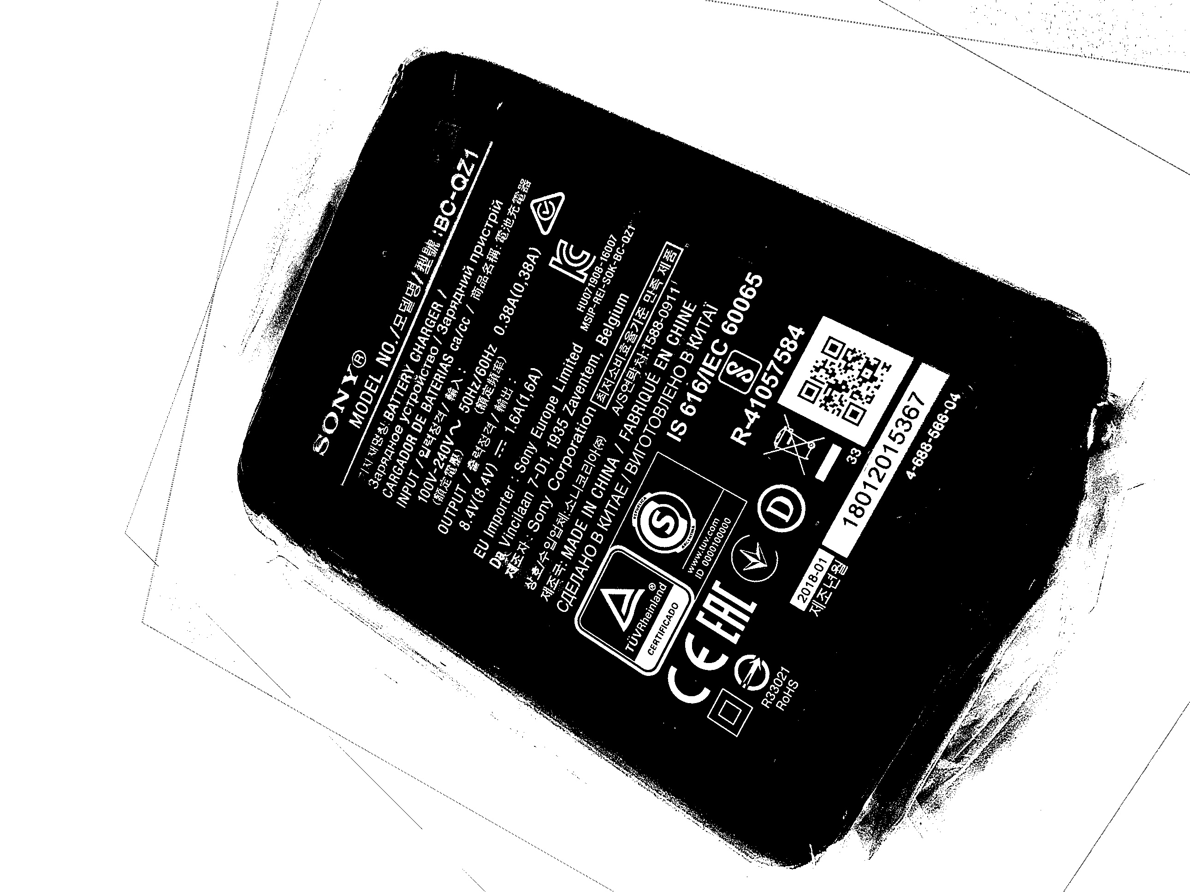
Binary
output

